Slide 1

Lesson 3: Dart Functions & Object-Oriented Programming (OOP)
TMA3084 - Software Engineering Laboratory
Lab Demo: MD. Aminul Islam Rakib
Lecturer: Madam Nurfauza Binti Jali
Page

Slide 2
Table of contents
01
Functions
02
Object-Oriented Programming (OOP)
03
Dart Project Structure and Dart Libraries
Lab 3: Create a Small Overtime Payment Program
Page

Slide 3
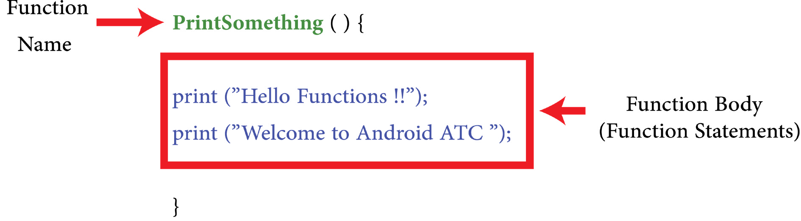
1. FUNCTION
Functions in Programming
A function is a named block of code that performs a specific task or returns a value. It helps avoid repeating code by allowing reuse through function calls. Functions make programs more organized, maintainable, and easier to modify. Most languages, including Dart, provide built-in functions stored in libraries.
Function Structure
Main components of a function
Page

Slide 4
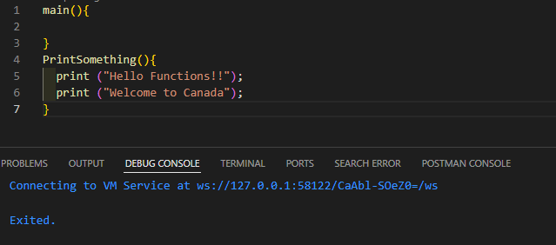
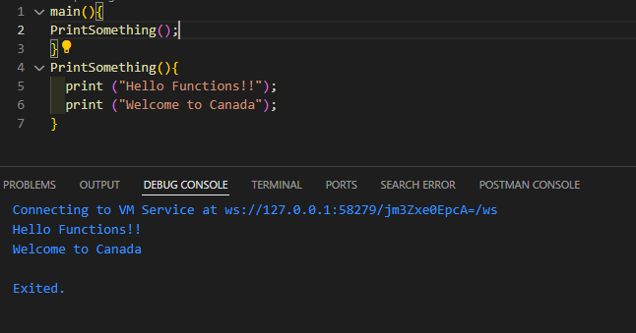
1. FUNCTION
Function Creation
Result will be empty as there is no function being called in main
Result is displayed after being called in main
Page

Slide 5
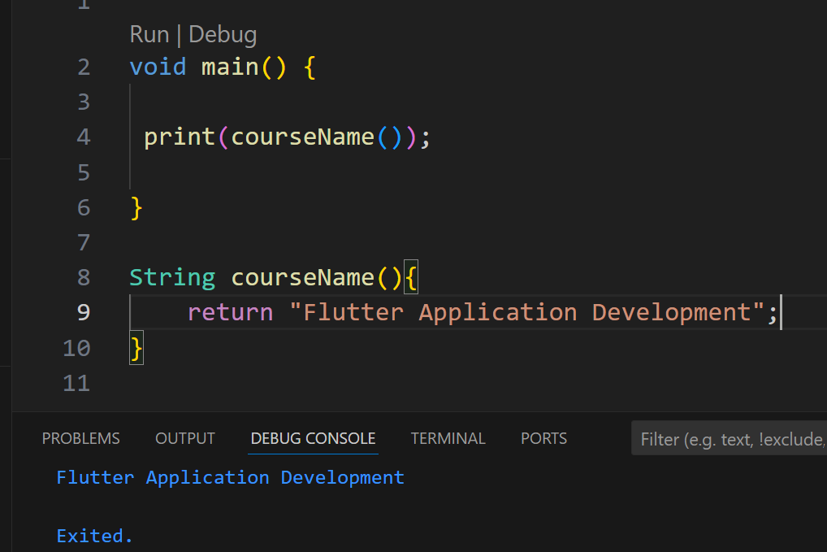
1. FUNCTION
Function Return String Data
Result is displayed because CourseName() is called in main() with print(CourseName()). This triggers the function to return the string, which is then printed.
Page

Slide 6
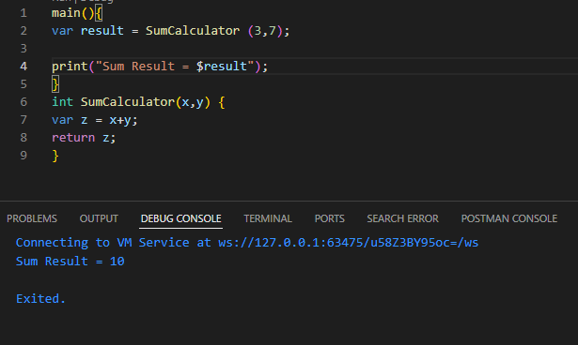
1. FUNCTION
Function Return int Data
In the previous example, it is important to add the return command at the end of the SumCalculator function. This will return the result of the addition operation, variable z, to the location from where the function was called.
Page

Slide 7
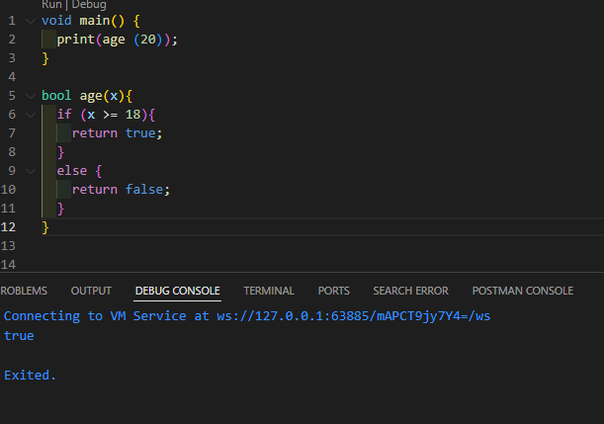
1. FUNCTION
Function Return bool Data
Page

Slide 8
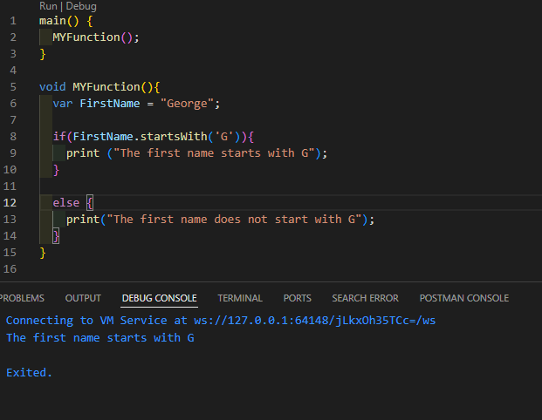
1. FUNCTION
Void Function
A void function does not return a value.
It performs tasks or changes data through its parameters.
If no return type is specified in Dart, it is treated as a void function
Page

Slide 9
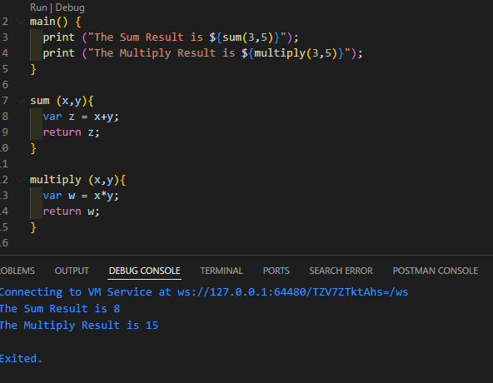
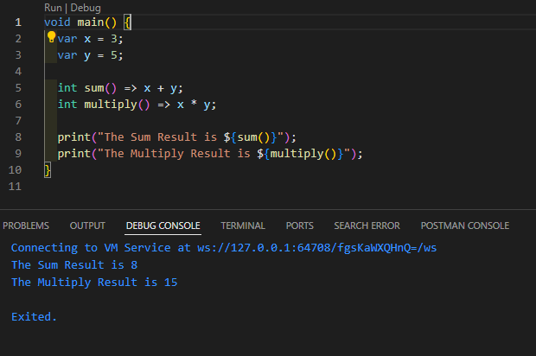
1. FUNCTION
Function Returning Expression
You can use “=>” operator for returning a value in a brief way.
Page

Slide 10
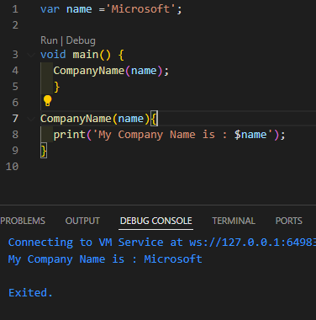
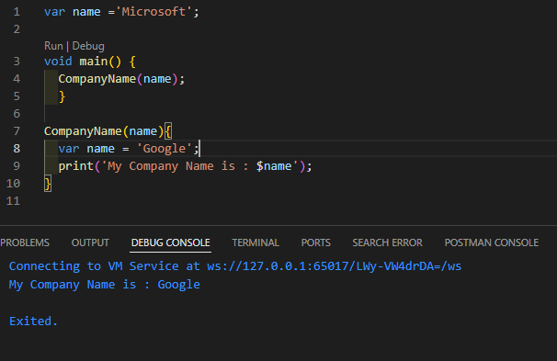
1. FUNCTION
Functions and Variable Scope
The position of a variable (inside or outside a function) affects how it’s used and accessed. It determines the variable’s visibility, lifetime, and how functions interact with it.
Page

Slide 11
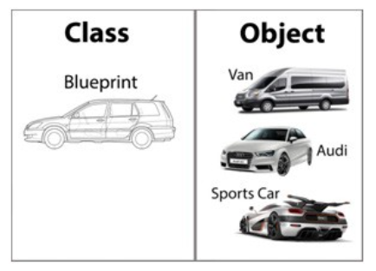
2. Object-Oriented Programming (OOP)
Class:
A class is a blueprint or template in object-oriented programming that defines the properties (attributes) and behaviors (methods) that the objects created from it will have.
Object:
An object is an instance of a class that contains actual values for the attributes and can perform the behaviors defined by the class.
Page

Slide 12

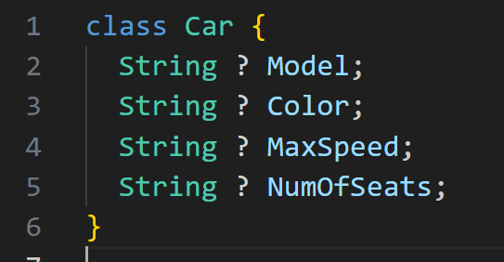
2. Object-Oriented Programming (OOP)
Creating a Class
Step 1: Declare an empty class called “Car”, as illustrated in the following code:
Step 2: The car class has been created. Now, you may add some properties to this Car class as illustrated in the following code:
Page

Slide 13
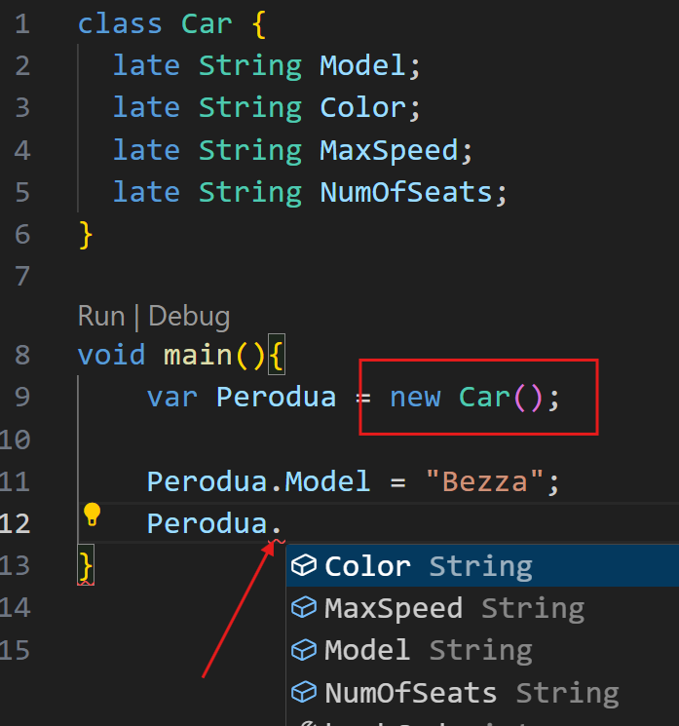
2. Object-Oriented Programming (OOP)
Step 4: To create an instance of the class or object, use the new keyword followed by the class name. Here, you can create an object depending on the “Car” class (blue print) which you have created in step 1, using the following code. Perodua is the name of the object which has all Car class properties or attributes values.
Page

Slide 14
2. Object-Oriented Programming (OOP)
Step 4: To create an instance of the class or object, use the new keyword followed by the class name. Here, you can create an object depending on the “Car” class (blue print) which you have created in step 1, using the following code. Perodua is the name of the object which has all Car class properties or attributes values.
Page

Slide 15
2. Object-Oriented Programming (OOP)
class Car { late String Model; late String Color; late String MaxSpeed; late String NumOfSeats; } void main(){ var Perodua = new Car(); Perodua.Model = "Bezza"; Perodua.Color = "Silver"; Perodua.MaxSpeed = '120KM/h'; Perodua.NumOfSeats = '5'; print("Car model name is ${Perodua.Model}"); }
Page

Slide 16
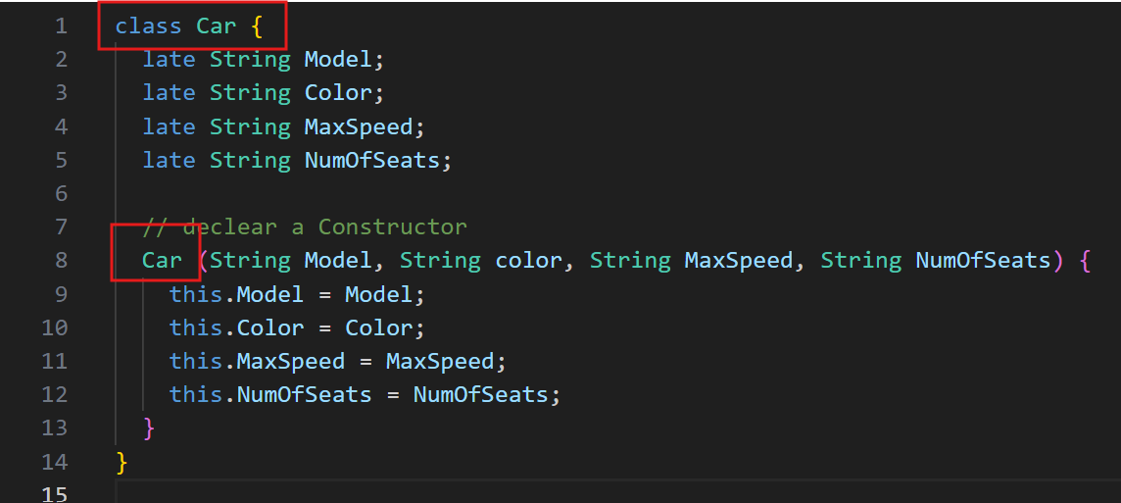
2. Object-Oriented Programming (OOP)
A constructor is a special method in a class that is automatically called when an object of that class is created.
The constructor has the same name as the class.
It does not have a return type (not even void).
It helps to set up the initial state of an object
Page

Slide 17
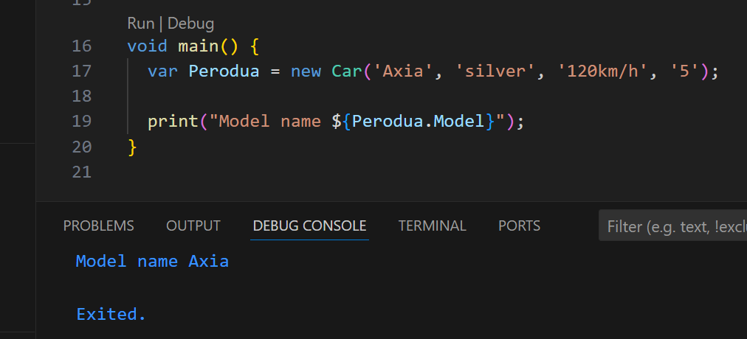
2. Object-Oriented Programming (OOP)
class Car {
late String Model;
late String Color;
late String MaxSpeed;
late String NumOfSeats;
// declear a Constructor
Car (String Model, String Color, String MaxSpeed, String NumOfSeats) {
this.Model = Model;
this.Color = Color;
this.MaxSpeed = MaxSpeed;
this.NumOfSeats = NumOfSeats;
}
}
void main() {
var Perodua = new Car('Axia', 'silver', '120km/h', '5');
print("Model name ${Perodua.Model}");
}
Page

Slide 18
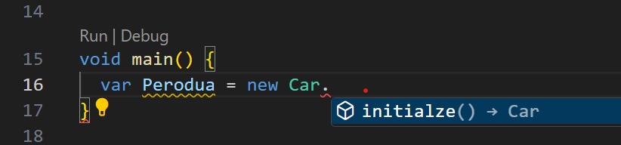
2. Object-Oriented Programming (OOP)
class Car {
late String Model;
late String Color;
late String MaxSpeed;
late String NumOfSeats;
Car.initialze(){
Model = 'Axia';
Color = 'White';
MaxSpeed = '130km/h';
NumOfSeats = '5';
}
}
void main() {
var Perodua = new Car.initialze();
print(Perodua.Model);
}
Initialize an object using a constructor name
Page

Slide 19
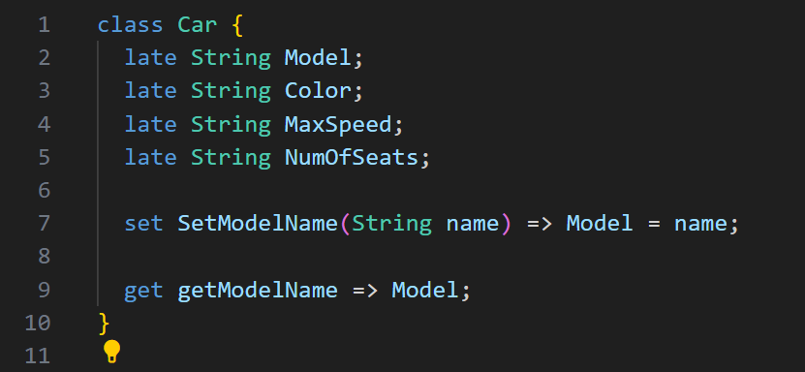
2. Object-Oriented Programming (OOP)
Class - Getters and Setters
A setter is a special method used to set (assign) a value to a private or protected variable.Getters are defined using the get keyword, whereas setters are defined using the set keyword.
A getter is a special method used to get (retrieve) the value of a property.
Page

Slide 20
2. Object-Oriented Programming (OOP)
Now, in the following code, we will use setType to set a value and getType to return or use this value.
class Car {
late String Model;
late String Color;
late String MaxSpeed;
late String NumOfSeats;
set SetModelName(String name) => Model = name;
get getModelName => Model;
}
void main() {
var Perodua = new Car();
Perodua.SetModelName = 'Bezza new 2025';
print(Perodua.getModelName);
}
Page

Slide 21
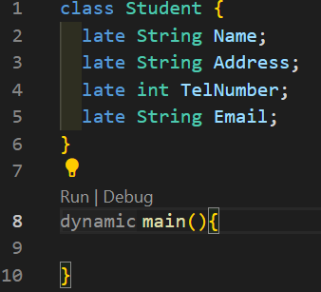

2. Object-Oriented Programming (OOP)
Class Inheritance
The idea of inheritance is simple but powerful. When you want to create a new class and there is already a class that includes some of the codes that you need, you can derive your new class from the existing class (called parent or super class). While doing this, you can reuse the properties and methods of the existing class without having to write them again.
Example:
Create new class Teacher with the same properties of class Student
Page

Slide 22
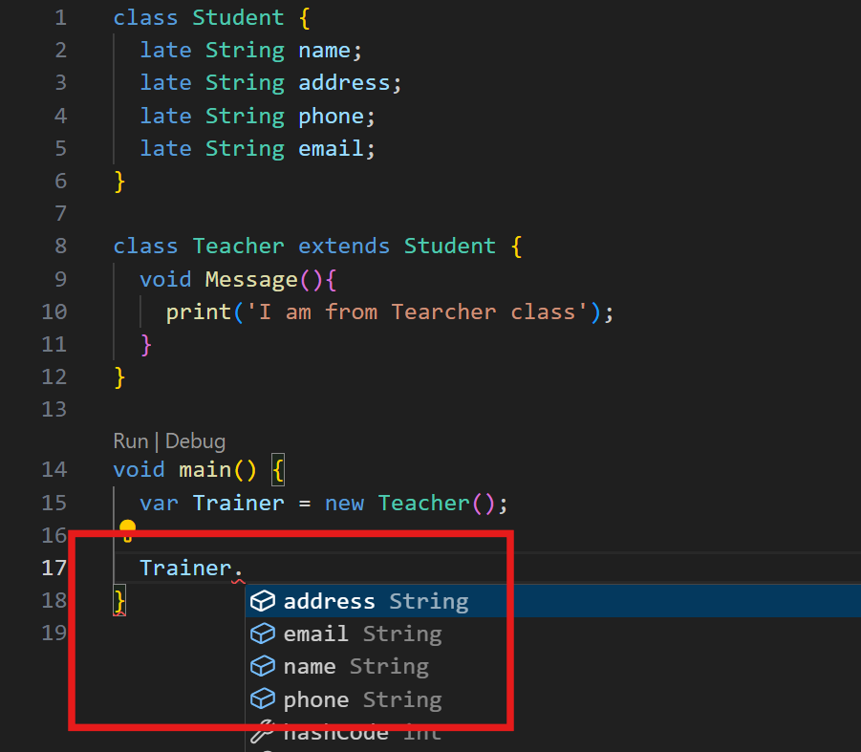
2. Object-Oriented Programming (OOP)
class Student {
late String name;
late String address;
late String phone;
late String email;
}
class Teacher extends Student {
void Message(){
print('I am from Tearcher class');
}
}
void main() {
var Trainer = new Teacher();
Trainer.name = 'Rakib';
}
Page

Slide 23
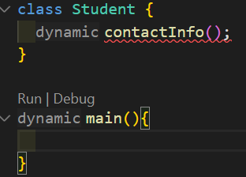
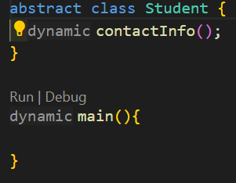
2. (OOP) Abstract Class
A class is called abstract when at least one of its methods or functions does not have an implementation (function body). It is the responsibility of the derived / child class to provide the implementation of the abstract members of the parent class.
An abstract class needs to be qualified with the abstract keyword. An abstract class cannot be instantiated, and its only purpose is to be inherited.
Example:
In the following example, Student is a normal class. If you added the contactInfo method to this class without a method body , you will get an error as illustrated in the following code:
Page

Slide 24
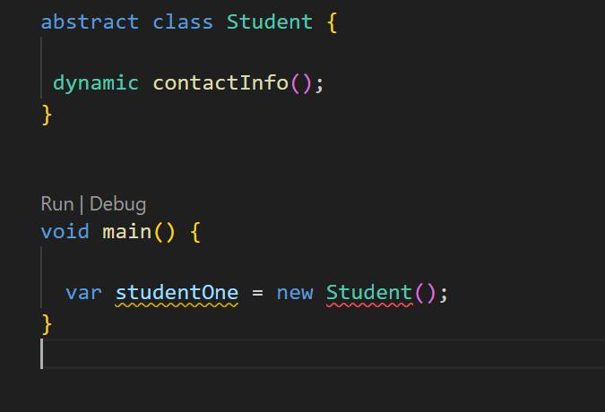
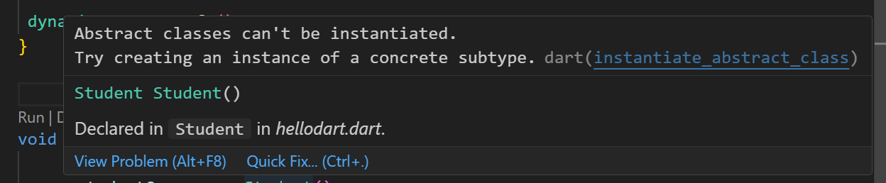
2. (OOP) Abstract Class
Also, you can’t create an object directly using this abstract class. If you try, you will get an error (red underline) as illustrated in the following screenshot:
Example:
Page

Slide 25
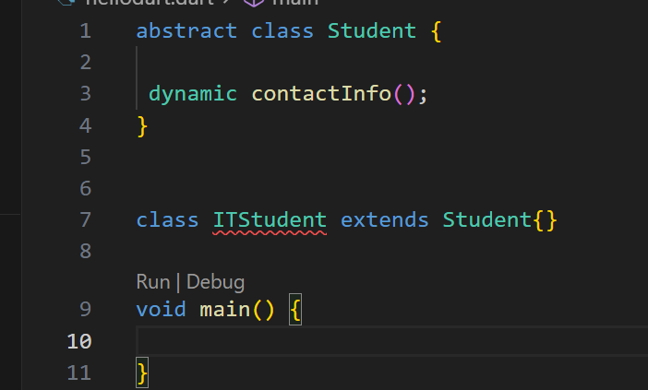
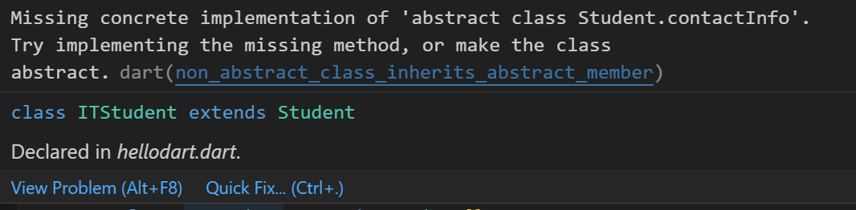
2. (OOP) Abstract Class
Instead of that , you should create a child class that inherits these abstract class (Student) properties and abstract methods, then use this child class in creating new objects.
In the following code, ITStudent is a child class, and will inherit all the Student (parent class) properties and methods. When you type the following code , you will see a red underline below ITStudent because the abstract class ITStudent includes an empty abstract method called contactInfo.
Page

Slide 26
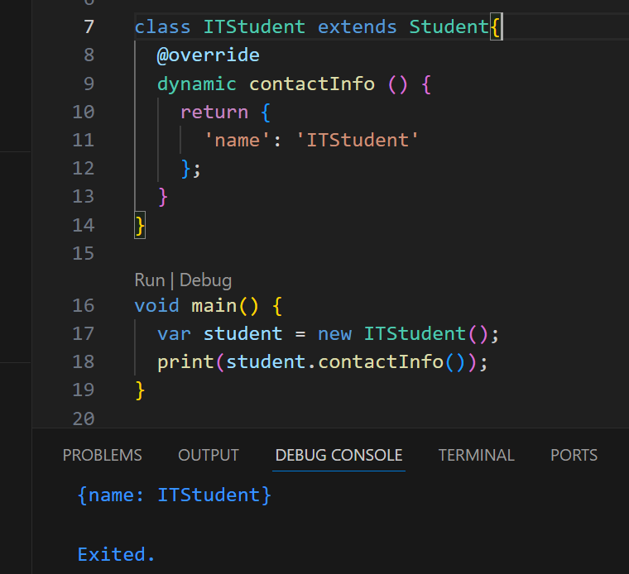
2. (OOP) Abstract Class
You can create the student object from the ITStudent class as illustrated in the following code:
Page

Slide 27
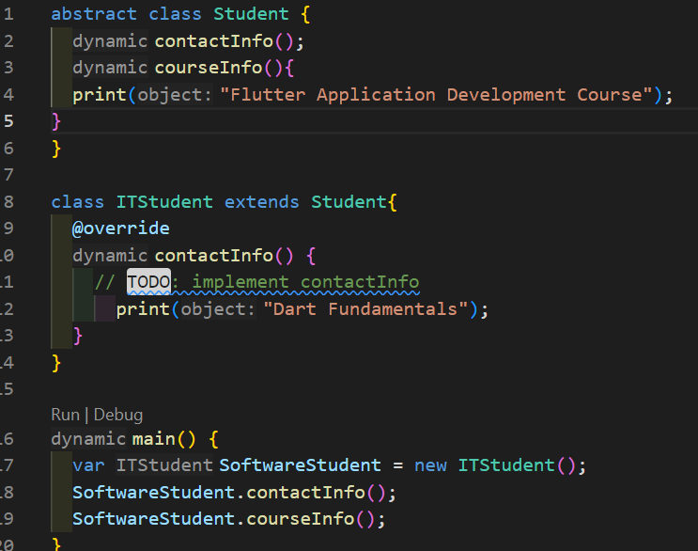
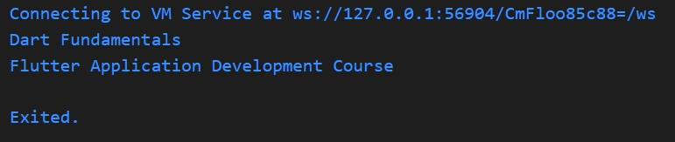
2. (OOP) Abstract Class
Although this abstract class has abstract methods, it can include normal methods also. For example, you can add CourseInfo method with a method body to your abstract class: Student as illustrated in the following code :
Page

Slide 28
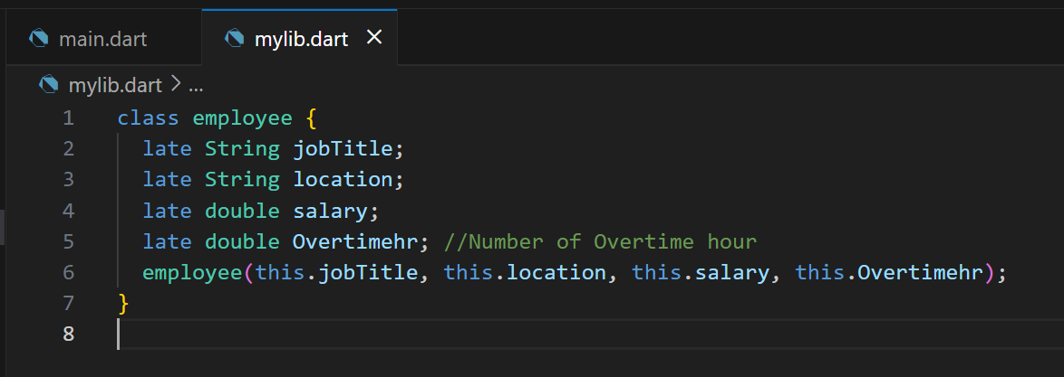
Create a Small Overtime Payment Program
Step 1: Set Up the Project in Visual Studio Code
1. Open Visual Studio Code and click on `File → Open Folder`.
2. Create a new folder named `Lab3` and open it in VS Code.
Step 2: Create `myLib.dart` Library File
1. In VS Code, right-click on the `Lab3` folder in the file explorer, and select **New File**.
2. Name the file `myLib.dart` and press Enter.
3. In `myLib.dart`, define the `employee` class with its properties and methods. Write the following code:
class employee{
late String jobTitle;
late String location;
late double salary;
late double Overtimehr; //Number of Overtime hour
employee(this.jobTitle, this.location , this.salary, this.Overtimehr);
}
Page

Slide 29
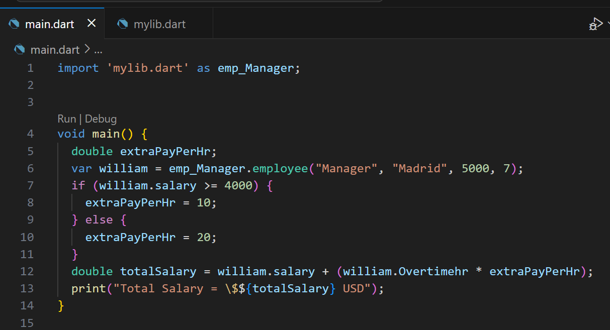
Create a Small Overtime Payment Program
Step 3: Create main.dart File
Right-click on the Lab3 folder again and select New File.
Name the file main.dart and press Enter.
Open main.dart and type the following code:
import 'mylib.dart' as emp_Manager;
void main() {
double extraPayPerHr;
var william = emp_Manager.employee("Manager", "Madrid", 5000, 7);
if (william.salary >= 4000) {
extraPayPerHr = 10;
} else {
extraPayPerHr = 20;
}
double totalSalary = william.salary + (william.Overtimehr * extraPayPerHr);
print("Total Salary = \$${totalSalary} USD");
}
Page

Slide 30
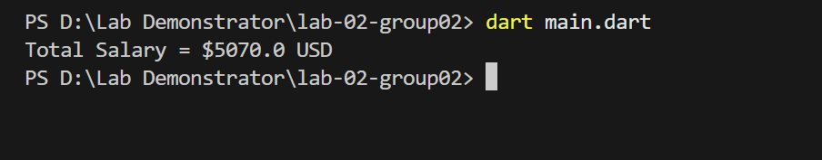
Create a Small Overtime Payment Program
Step 4: Run the Program
In VS Code, open the Terminal by selecting Terminal → New Terminal.
Run the program by typing:
bash
Copy code
dart main.dart
Page

Slide 31
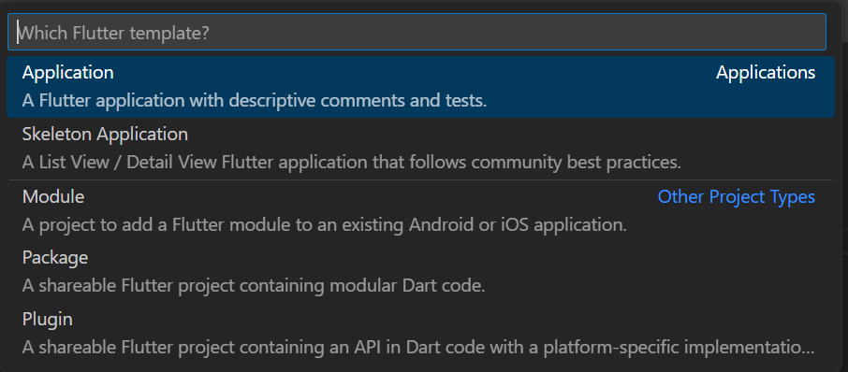
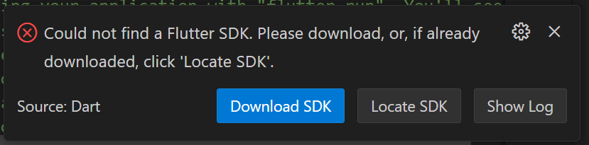
3. Dart Project Structure and Dart Libraries
When creating a Flutter application, click on Ctrl + Shift + P (Show and Run Commands). Click on Flutter > New Project
First time you show an error message
Page

Slide 32
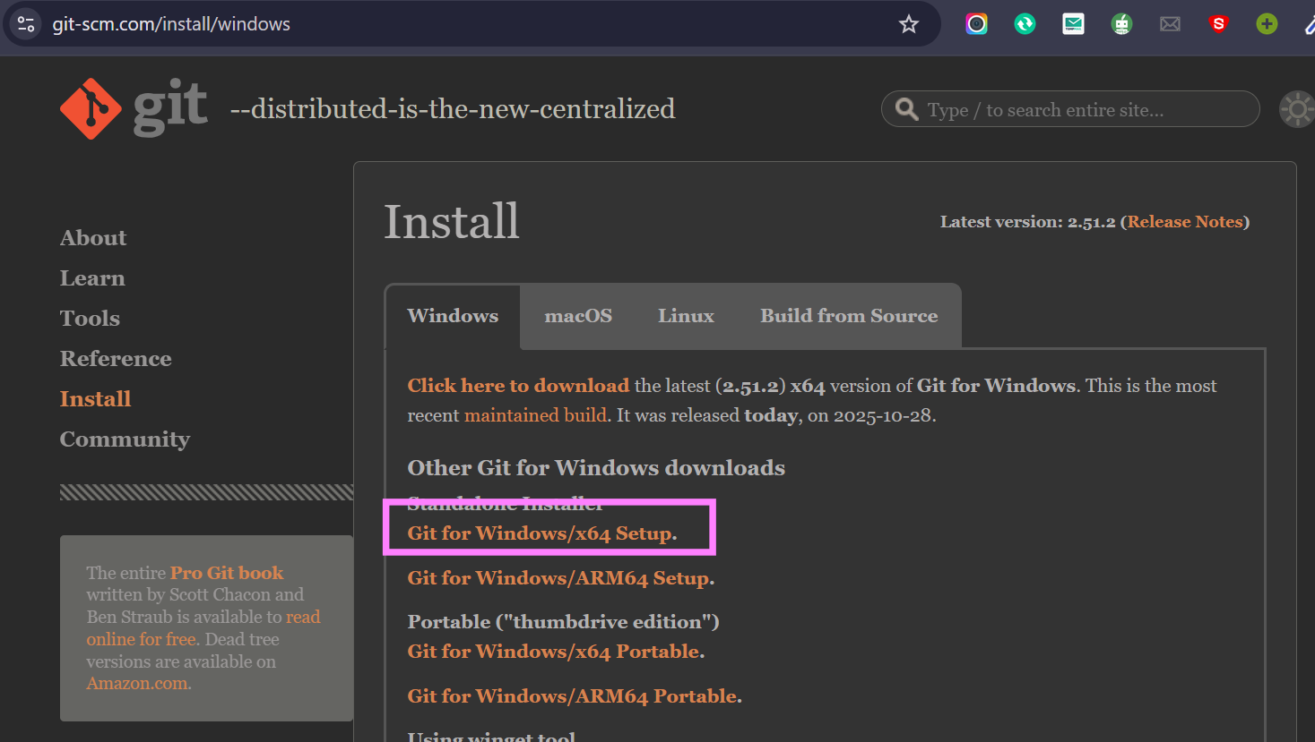
3. Dart Project Structure and Dart Libraries
In here if you want to download SDK
you need to install Git
Click here download the git and install it
Page

Slide 33
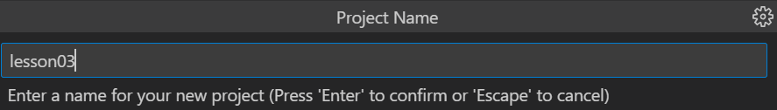
3. Dart Project Structure and Dart Libraries
Step 1- First time install the flutter sdk
Click here => https://docs.flutter.dev/install/manual
Step 2 - Extract the zip file
Step 3 – Go vs Code and click Locate SDK
And select this path: local_computer_disk: flutter_windows_3.35.7-stable\flutters\bin
Now Select you folder and project name
Page

Slide 34
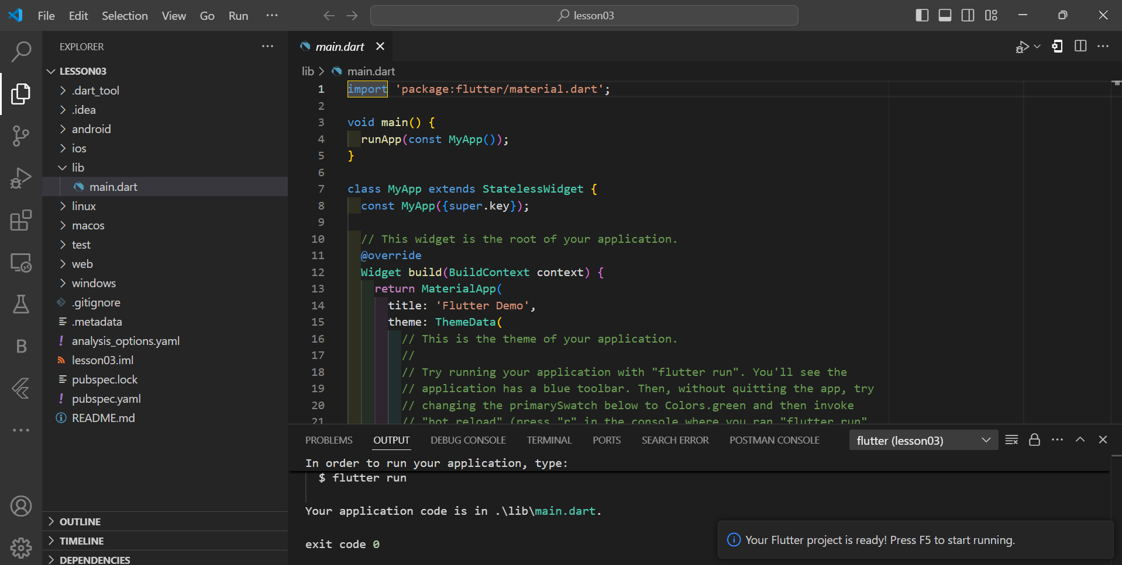
3. Dart Project Structure and Dart Libraries
Select you folder and project name
test/: This directory is for testing files, where you can write and organize unit tests for your project.
lib/:
This directory contains all your Dart library files. It’s common to place main code files and utility files here if you are building a package or a library. For a small project, you may skip this directory and keep all files at the root level.
pubspec.yaml: This file is the main configuration file for Dart projects. Here, you define project dependencies, environment settings, and metadata like the project name and version.
Page

Slide 35
3. Dart Project Structure and Dart Libraries
1. Check pubspec.yaml for Dependencies
In Dart projects, all external libraries (or dependencies) are listed in the pubspec.yaml file, located at the root of your project.
Open pubspec.yaml to add or view the libraries under the dependencies or dev_dependencies sections.
2. Download Libraries Using pub get
Once you’ve added dependencies in pubspec.yaml, run flutter pub get in the terminal to fetch the libraries.
VS Code’s Dart extension may also prompt you to fetch packages automatically when you save changes to pubspec.yaml.
Page

Slide 36
Any Questions?

Slide 37
Thank you

